Slide 1

TELEMEDICines
Salman Junaid , Sobia Jawed

Slide 2
Introduction
We are students at Sir Syed University Of Engineering & Technology studying Software Engineering; we came up with the idea of merging medicines with technology termed "Telemedicine" to strengthen Pakistan's medical system. We are enabling access to healthcare via electronic means and contributing in social and economical advancement of health-care system. Implications of these services will facilitate to improve access to specialized medical treatments, shorten waiting lines, and improve physician proficiency.

Slide 3
Company Name
SJ-Telemedicine

Slide 4
PITCH
So the main problem that we are trying to solve with our idea is that in medicines world doctors cannot reach everywhere to help the patients and there are many cases where the lives of the patients have been in danger because they got late treatment. Around 28.7% of registered deaths took place because of lack of medical attention in 2016. With our idea we can solve this problem because we will create a platform/website where the medical consultancy will be available from anywhere
How it will work is that we will create a website where the client can login and can search for a specific consultancy the website would suggest multiple specialist online and ready for a chat or video call.
From a business perspective our idea would generate money in two ways first we would run add on our website and secondly client would have to pay a small subscription fee to get access to our website.

Slide 5
PITCH
The compition of this idea in the market place is very low in Pakistan as there are very few companies right now that are working on this type of business like
Dawayee
Teledoc
Find my doctor
Oladoc
But still there is huge market place for this kind of business and with the right marketing we can make huge impact on the market

Slide 6
Team Members
Sobia Jawed (2020-SE-180)
Salman Junaid (2020-SE-183)

Slide 7
What We Do?
We are the students of Software Engineering ( Sir Syed University Of Engineering & Technology ), and we are here today to talk to you about tele-medicines and how it is changing the way of health-care, who’s benefiting from it already and how we are implementing this kind of technology in Pakistan.

Slide 8
Our Targets
Making health-care accessible from under served location.
To promote proficiency of physicians and other health care personal.
To reduce the waiting list in specialized health care.
To save Money.
Making critical care and specialist services available in rural and remote area’s.

Slide 9
Our Achievements
We are trying to convince multiple high class doctors to come on board to our platform to facilitate the patients with high care

Slide 10
Profit & Loss
The global telehealth market size was valued at USD 83.5 billion in 2022 and is projected to expand at a compound annual growth rate (CAGR) of 24.0% from 2023 to 2030 Further, the growing need to monitor health and wellness in order to manage chronic diseases virtually is driving the market growth.

Slide 11
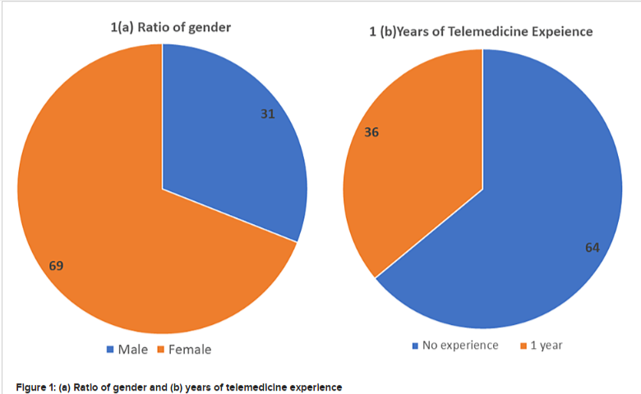
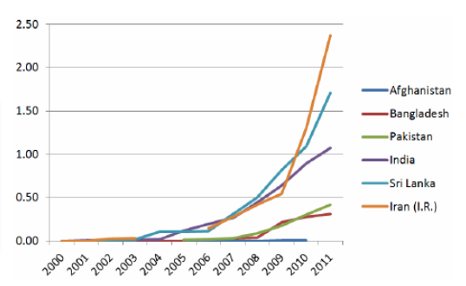
Profit & Loss

Slide 12
Financials
One of the basic ways through which telemedicine apps make money is through monthly or annual payment plans. The patient and the doctor both need to pay a certain amount of fee for using the software. You can either create a membership plan on an annual or quarterly basis and give them discounts to enroll in them

Slide 13
Our Dreams
Our dream is that our idea will reach even the most urban areas and will help to save countless lives and revolutionize the health care system of Pakistan.

Slide 14
REFERENCES
https://www.grandviewresearch.com/industry-analysis/telehealth-market-report
https://www.cureus.com/articles/122254-perception-and-attitude-of-pakistani-doctors-toward-the-use-of-telemedicine-technology
https://www.researchgate.net/publication/270850940_Prospects_for_Mobile_Health_in_Pakistan_and_Other_Developing_Countries
https://www.bdo.global/en-gb/blogs/tech-media-watch-blog/july-2021/telemedicine-and-telecoms-%E2%80%93-a-new-treasure-trove-or-pandora%E2%80%99s-box-of-data

Slide 15
“Thank you”

